Slide 1
Capstone Project – Web Scaping and Machine Learning Project
Rohinth Shanmugasundaram
DADS AUG 2025 Batch B

Slide 2
Introduction:
This project focuses on applying data science and machine learning techniques to analyse product data collected from an e-commerce platform.
The objective was to understand patterns in pricing, ratings, and product categories.

Slide 3
Project Overview:
Key variables analysed included
product price,
rating, and
category.
Unsupervised learning was used to identify natural groupings in the data, while supervised learning was applied to predict product categories. Multiple models were evaluated and compared using accuracy and F1-score.

Slide 4
Web Scraping:
Product data was collected from a publicly available e-commerce test website using Python libraries such as Requests and Beautiful Soup. The scraped attributes included product name, price, category, and rating.
Used – https://books.toscrape.com/ website to pull books across different genre’s or category.

Slide 5
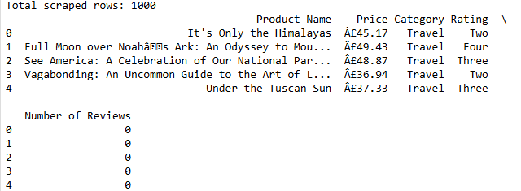
Data Cleaning:
Data Before Cleaning:

Slide 6
Data Cleaning:
Price values were standardized into numeric format – all the rows the price were in Euros they were stripped from the numeric column
Ratings were mapped into consistent numerical representations.
Duplicate entries and irrelevant records were removed to maintain data integrity.

Slide 7
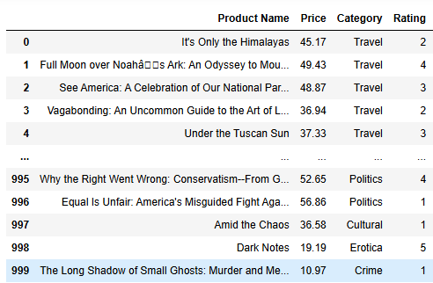
Data Cleaning:
Data After Cleaning:

Slide 8
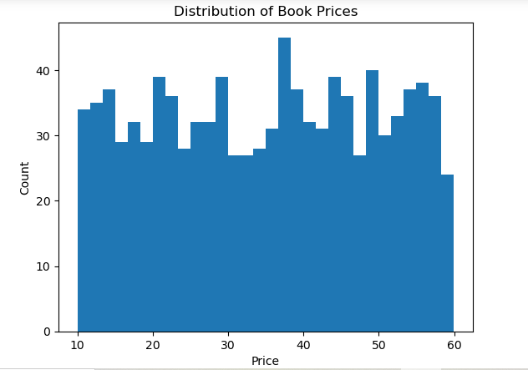
Exploratory Data Analysis (EDA):
EDA revealed that book prices were relatively evenly distributed within a specific range, indicating no extreme outliers.

Slide 9
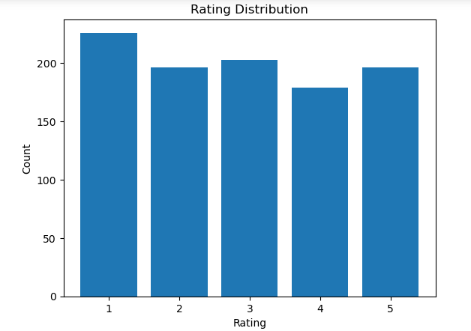
Exploratory Data Analysis (EDA):
EDA revealed that book prices were relatively evenly distributed within a specific range, indicating no extreme outliers.

Slide 10
Exploratory Data Analysis (EDA):
Book prices are widely distributed across the range, indicating the presence of both low-priced and premium books in the dataset.
There is no strong price concentration, suggesting a relatively balanced pricing strategy across products.
Ratings are fairly evenly distributed from 1 to 5, with no extreme skew toward only high or low ratings.

Slide 11
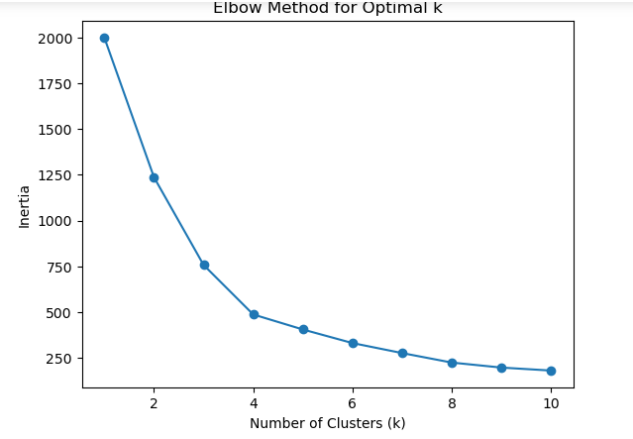
Unsupervised Learning:
K-Means clustering was used to identify natural groupings based on price and rating.
The elbow method indicated a noticeable reduction in inertia at four clusters, suggesting an optimal clustering structure.

Slide 12
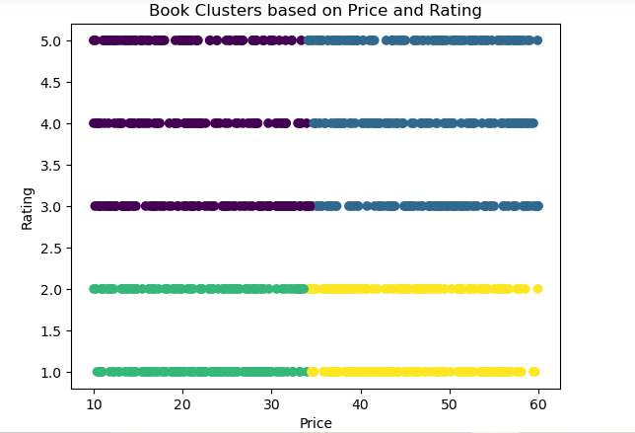
Unsupervised Learning:
Clusters showed patterns where products were grouped primarily by pricing tiers and rating levels. The analysis indicated that price had a stronger influence on clustering than rating.

Slide 13
Feature Scaling:
This step was necessary for algorithms sensitive to feature magnitude, such as K-Means, Logistic Regression, SVM, and KNN. Scaling ensured that no single feature dominated the learning process.
The Rating was converted to string for grouping
The category was encoded to numeric for prediction
They were scaled down to unique small-scale values.

Slide 14
Supervised Learning:
Multiple classification models were implemented to predict product category using price and rating as input features.
Logistic Regression was applied to examine linear separability and achieved an accuracy of approximately 21% with an F1-score of around 0.14, indicating limited linear relationships between features and categories.
Support Vector Machine (SVM) explored non-linear boundaries and produced similar performance, with accuracy near 19–22% and F1-scores improving slightly after tuning, suggesting marginal benefits from complex decision boundaries.

Slide 15
Supervised Learning:
K-Nearest Neighbors (KNN) analysed similarity based on feature distance and showed moderate performance, with accuracy around 19–20% and F1-scores near 0.19 after optimization, indicating some improvement when neighborhood parameters were tuned.
Random Forest evaluated non-linear feature interactions through ensemble decision trees and achieved accuracy between 17–18% with F1-scores around 0.17, reflecting stable but limited predictive capability.

Slide 16
Supervised Learning:
XGBoost applied gradient boosting techniques and delivered comparable results, with accuracy close to 18–19% and F1-scores near 0.18, reinforcing that feature informativeness, rather than model complexity, was the primary factor influencing performance.
however, both ensemble models showed only modest gains, reinforcing that limited feature informativeness constrained overall predictive accuracy.

Slide 17
Hyperparameter Tuning:
Grid search was used to optimize parameters for KNN, SVM, and Random Forest models. Tuning resulted in modest improvements in accuracy and F1-score, particularly for KNN and SVM. Random Forest showed more stable performance after optimization.

Slide 18
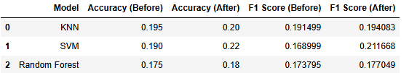
Hyperparameter Tuning:
However, improvements were limited, confirming that feature informativeness constrained performance. This step reinforced that tuning enhances stability rather than overcoming weak predictors.

Slide 19
Conclusion:
The project demonstrated that unsupervised learning was effective in identifying natural groupings within the dataset based on price and rating.
K-Means clustering revealed meaningful segments, suggesting that these features capture general patterns in product positioning.
However, supervised learning models showed limited success in predicting product categories, indicating that price and rating alone are weak predictors of labelled outcomes.
The contrast between the two approaches highlights that while the data contains inherent structure, the selected features were insufficient for accurate classification.

